Slide 1

CS 134 Computer Game Design – 3D Graphics
Instructor: Kevin M. Smith

Slide 2
3D Collisions
There are two processes we need to support collision
Collision Detection
Detect which parts of object(s) will intersect each other
Sometimes called “the contact point(s)”
Collision Resolution
What to do to resolve the collision ?

Slide 3
3D Collisions - Intersection
How to we determine contact points for an object A colliding with object B ?
At each frame, we could do a search for points in object A that are near object B.
For small simple objects, that might be OK.
For more complex/realistic scenes (like the Mars ground plane), that would take way too much time.
EX: Mars geometry has about 210,000 vertices, so we need to do distance calculations on all these points (multiplied by points in our object).
How can we optimize that ?
Spatial Partitioning – we will use Octrees as our example.

Slide 4
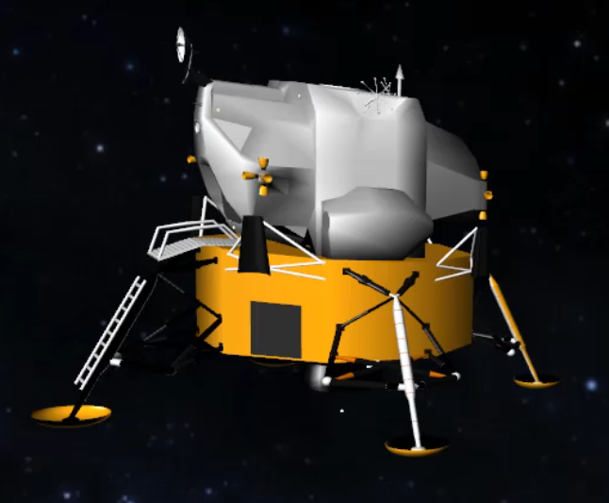
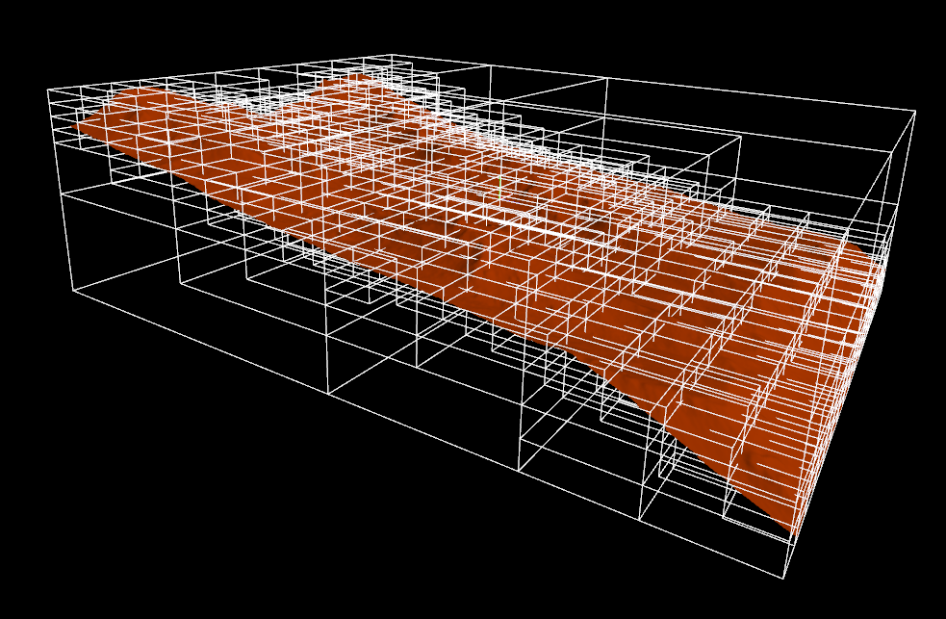
3D Collisions - Intersection
For Octree Partitioning
Very similar to ray trace selection, we will do a “hierarchical search” on the geometry by calculating if points on our object A comes close enough (or is inside) a box in object B containing points.
If a point in B is within an pre-determined “epsilon” distance of our object A, we deem them to be “in contact”.

Slide 5
3D Collisions – Intersection Test Algorithm
Starting Conditions
Object A – is in a bounding Box (has 4 points, one for each corner)
Object B - is in an Octree ( < 25 points per leaf box – as an example)
Object A/B are moving relative to each other with known velocities.
Algorithm (to find closes point of contact)
For each point in A,
Search Octree in Object B for a box that either contains the point (or is within a given distance, epsilon of point.
Recursively traverse tree until we find a “leaf” box that meets same criteria.
Search points in the leaf box to find the nearest point.
This is marked as the “contact” point
Store all contact points and their distances for each point in A that intersects

Slide 6
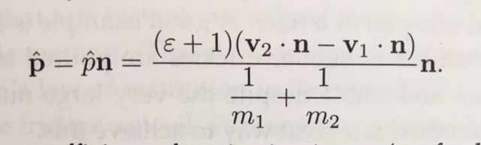
3D Collisions – Collision Resolution
Once we know a collision occurs, we can generate an “Impulse Force” to act on the object.
An Impulse Force is a reactive force that occurs over a very short time frame. In this case, it is force we produce in just one timestep (or one frame).
The Impulse Force (p) is going to act on the object to move it in a reflective direction from the collision surface, based on relative velocities of the object(s) and surface normal. General equation at right.
The epsilon in this equation is the “restitution” of the material. If e = 1.0, the object is perfectly bouncy. If e = 0.0, the object is completely dead (doesn’t bounce.
We can simplify the equation above if the velocity of object 2 (v2) is zero (stationary) and of infinite mass (like terrain). Also assume the mass of the moving object is 1.0 for the moment.
The Equation then simplifies to:
P = (e + 1) * ( -v .dot. n ) * n;
Where v is the velocity of the moving object
n is the normal at the contact point.
e is the material restitution in [0, 1]

